Slide 1
7th Sense Advance Automation

Slide 2
Project Team Members
Vimal Mishra 170160116042
Jay Gohil 170160116025
Mahavirbha Chauhan 170160116014
Kruti Chauhan 170160116013
Internal Guide
Prof. Vimal Rathood

Slide 3
Introduction
We are introducing 7th sense advance automation to level up 6th sense technology using artificial intelligence. AIoT base home automations are existing but there are lack of some automations & personalization. With our product we can achieve highly automated and system for real world interactions.

Slide 4
Technology
python
Arduino
IoT
Neural Networks
Computer vision
Natural Language Processing

Slide 5
Frameworks
scikit-learn
TensorFlow
TensorFlow Lite
Keras
spacy
NLTK
openCv

Slide 6
Home Appliances
220v AC
Projector
220v AC to 5v DC
Camera
Headset
5v to 3.3 v
Relay
Mobile
Laptop
RPi
ESP32
Temperature sensor
Speaker
Camera
Mic

Slide 7
Computer Vision
Capture image
Object detection
Face detection
Gesture classification
output

Slide 8
Natural Language Processing
Take voice input
Convert voice data into text data
Natural language understanding
Natural language generation
Speak

Slide 9
Chatbot
Training Corpus Data
Data Pre-processing
TF-IDF
Cosine Similarity

Slide 10
ESP32
Protect Rpi from damage from I/O pins
I/O program
Take input from sensors
Control I/O devices

Slide 11
Rpi Flowchart
Start
system on
No
Yes
Mapping
Objects
Object
Detection
dived into frames
take input from camera
Request the state of home appliances from ESP32
take input from mic
No
Object Found
Person found
No
Turn off devices
convert audio data into text
Yes
Yes
gives location
map the device state to situation
Weather/ Surround Detection
Brighness Detection
Natural language understanding
update the state of device
Recognize emotion
Recognize emotion
Recognize the person
Recommandation/Customizes Playlist
Stemming
Removing Stop
words
YES
Query ?
Pose Estimation
Spell check
NO
Recognize emotion
Matching the words with the tags in the
Database
Getting the products which match the tags
Natural language generation
personalize the seen according to user
Speak
Recognize the Gesture
map output to gesture
End

Slide 12
Mobile Flowchart
Start
system on
No
Yes
No
camera available
take input from mic
Yes
take input from camera
convert audio data into text
Mapping
Objects
Object
Detection
Natural language understanding
dived into frames
Recognize emotion
Recognize the Gesture
Stemming
Removing Stop
words
YES
Query ?
map output to gesture
Spell check
NO
Matching the words with the tags in the
Database
Getting the products which match the tags
Natural language generation
Speak
End

Slide 13
ESP32 Flowchart
Start
True
get state of home appliances
connect wifi with Rpi
NO
connected
Read input from Rpi
NO
present
YES
value match with state of home appliances
return -1
YES
expression
light
toggle the state of light
fan
change the speed of fan
socket
toggle the state of socket
END

Slide 14
Activity diagram
Seventh Sense Automation System
user
moblie
Rpi
controller
User Log In
Verify Log In Details
Invalid Details
Return to Log In Page
Invalid
Valid
Check user level and permissions
Server and system initialization
Verify if Input is for operating home appliances
User Input for mobile
initialize cam for headset
User Input for Rpi
NO
YES
Verify if Input is for operating home appliances
Verify if input is general query
NO
YES
YES
NO
Verify if input is general query
YES
NO
Verify if it is command to operate electronic devices
natural language understanding
Verify if it is command to operate electronic devices
natural language understanding
Yes​
Divide Frame
by Frame
Performs
coversation based on its communication skills
execute command
No
execute command
Divide Frame
by Frame
Brightness
Detection
Object
Detection
Perform task on home appliances according to user input
Object
Detection
Project information
Mapping
Objects
Person
Detection
UML-Activity-Diagram
UML-Activity-Diagram
NO
Mapping
Objects
Recognize the Gesture
return location of object
YES
execute the task
Pose
Estimation
Recognize the person
map the device state to situation
read information of object
show information about object
map the device state to situation
Recognize emotion
Recognize the Gesture
Performs
coversation based on its communication skills
execute the task

Slide 15
ER diagram
Email-Address
Password
Code
Mobile No.
UserName
First​ Name
Member
Address
Code
Last Name
Room Name
Code
First​ Name
Password
UserName
Room
Last Name
Address
UserAdmin
Can ON/OFF
Address
House Name
Email-Address
1
House
Mobile No.
Code
Can Add/Update/Delete
Appliance
Appliance Name
Code

Slide 16
Use case diagram
natural language understanding
<<include>>
take input from mic
Ask general queries
<<include>>
<<include>>
<<include>>
Recognize emotions
Operate home appliances
natural language generation
object detection
<<include>>
<<include>>
take input from camera
Rpi
user
Operate digital devices
<<include>>
<<include>>
<<include>>
Recognize Person
<<include>>
Recognize Gesture
Perform conversation
<<include>>
Speak
take input from mic
<<include>>
natural language understanding
<<include>>
<<include>>
Speak
Project Content
natural language generation
Mobile
<<include>>
Control AC Fan
take input from camera
<<include>>
object detection
<<extend>>
Monitor Home Condition
<<extend>>
Control home appliances
<<extend>>
ESP32
Control lights
take input from sensors

Slide 17
Sequence diagram
User
RPi / mobile
Microcontroller
Home Appliancies
user input​
opt
user input​
[ if user input is for operating home appliances ]
Operate appliances based on user input
[ else if user input is about digital query ]
Process digital query and implement it
[ else if user input is about general query ]
Process general query and implement it
[ else ]
Process user input statemnt
​gives processed reply​

Slide 18
Data flow diagram
Invalid
Acknowledgment
P2i Gesture recognition
P2j Recognize Emotion
User
Log In Request
P1 Verification
Log In Details
D1
Authentication record
recognize the gesture
using model data
Object Data
Recognizes Emotion Person
Verify Log-in Details
Gives Input
Valid
Server and system current state
Object Data
Recognized Data​
P3 UserInput
P2 Initialization
D2
Server and system state
P2f Person Recognition
P2k reply to user
Reads User Input
Server and system Initialization
Request to start camera
Recognizes Person using trained model
reply to user based on its communication skills
Statement Check
Command for operating home appliances
Camera
Detected Values
User Input
P3a InputTypeCheck
P3b HomeAppliancesOperation
Video
Stream
Verify if input is for operating home appliances
Operates home appliances according to user's instructions
P2a Video Capture
P2e Person Detection
D3
User Input Database
User Input
Capturing Video Stream from Camera
Detecting Persons from Detected Objects
D4
communication Database
P3c InputTypeCheck
Query
Video
Stream
Objects's
Information
Verify if input is for general query
RPi
P2d Object Detection
P3c Training
User Input
Command for operating digital devices
Video
Stream
Frames
Detecting Objects from Frames
Training for further usage
P3d InputTypeCheck
P3e DigitalQueryProcessing
P2b FrameByFrame
Frames
Verify if input is for digital query
perform digital task
Divide Input into Frames
P2g Object Mapping
User Input
Frames
map objects according to their tags
P3f natural language understanding
P2c Brightness Detection
Reply
Interpreted Data
detecting Brightness through frames
P2h GeneralQueryReply
understand the meaning of input data
Replies with maximum possible accuracy using all its resources

Slide 19
Class diagram
Sensors
Camera
Communication
Projector
- key : char
- state : bool
+ connect()
+ sendToRpi()
+ reciveFromRpi()
+ getKey()
+ getState()
ESP32
RPi
Microphone
Chatbot
ObjectDetection
+​userInput : str
+userInputWithoutStopwords : np.array
+rootWords : np.array
+matchedTags : np.array
+nlgOutput : str
+ classes : list
+ colors : np.array
+ imgId : lint
+ confidences : list
+ boxes : list
Appliances
+readUserInput()
+convAudioToText()
+nlu()
+checkSentencetype()
+removeStopWords()
+spellCheck
+stemming
+wordsMatchingWithDbTags()
+getProductsFromMatchedWords()
+nlg
+speak()
Fan
- sate : bool
- type : char
+ videoCapture()
+ readFrameByFrame()
+ readModel()
+ boundingBox()
+ showFrame()
+ initialize()
- turnOnDevice()
- turnOffDevice()
- slowDown()
- boostUp()
- setState()
+ getState()
Light
FaceRecognition
GestureRecognition
- face_cascade :
- abels : dict
- faces : object
- roi : object
+ loded_model : model
+ categories : dict
+ frames : object
+ roi : object
+ predictions : dict
- videoCapture()
- readFrameByFrame()
- readClassifier()
- callRecognizer()
- readRecognizer()
- readCapture()
- recognizeFace()
-
+ videoCapture()
+ readFrameByFrame()
+ resize()
+ loadModel()
+ predict()

Slide 20
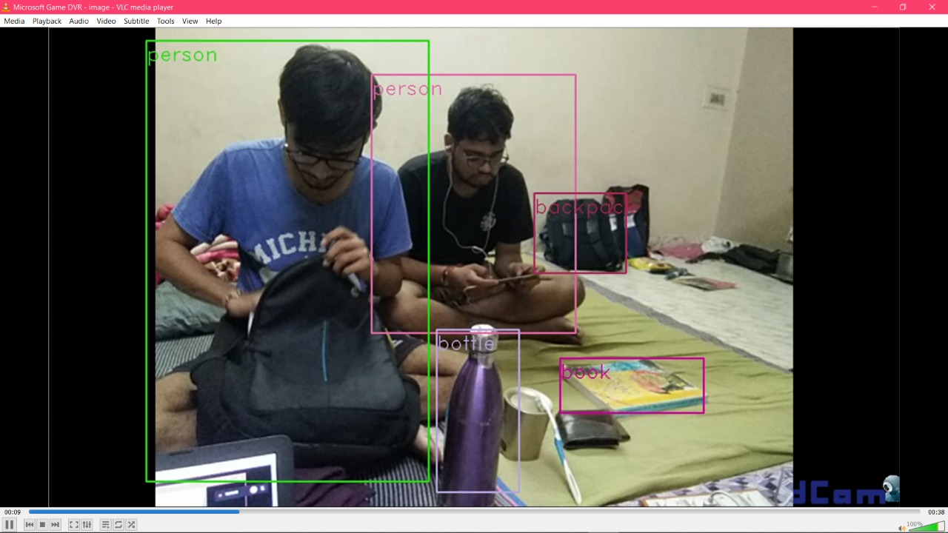
Object Detection

Slide 21
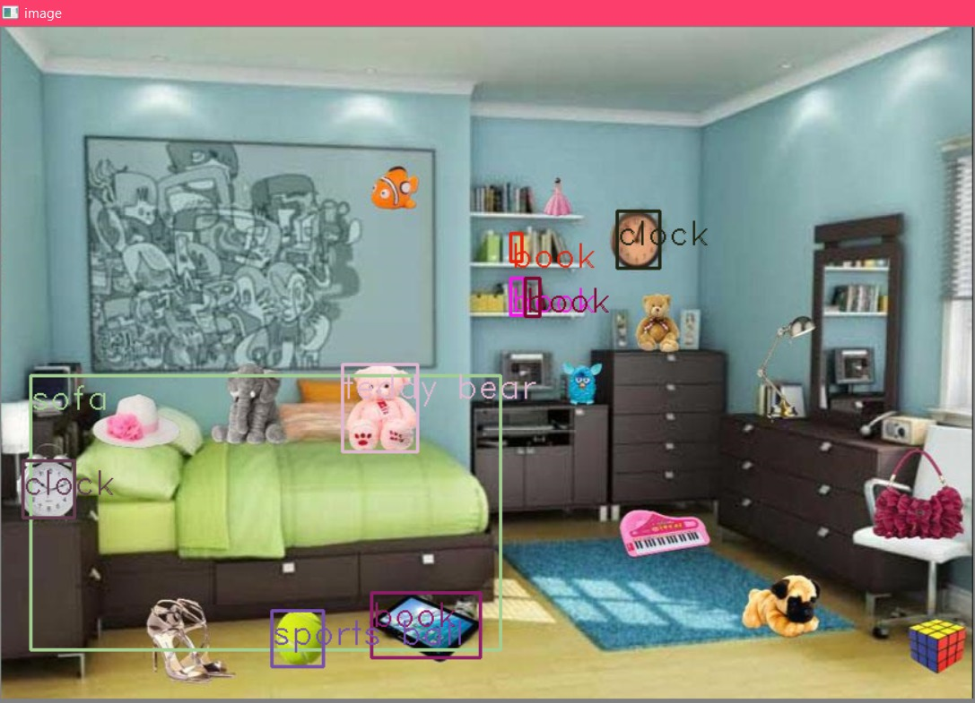

Slide 22
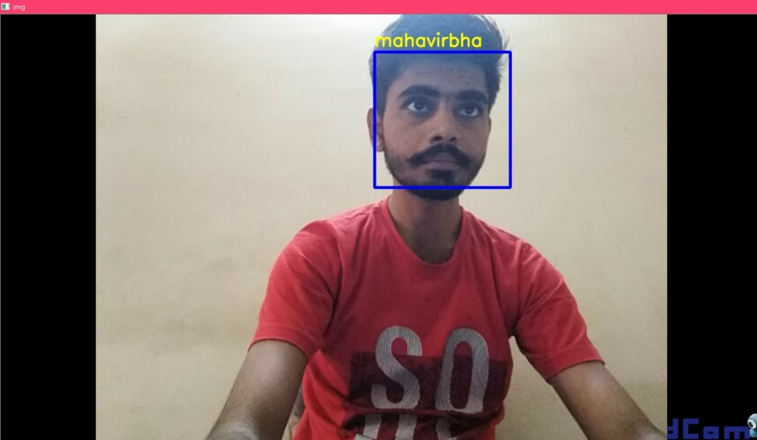
Face Recognition

Slide 23
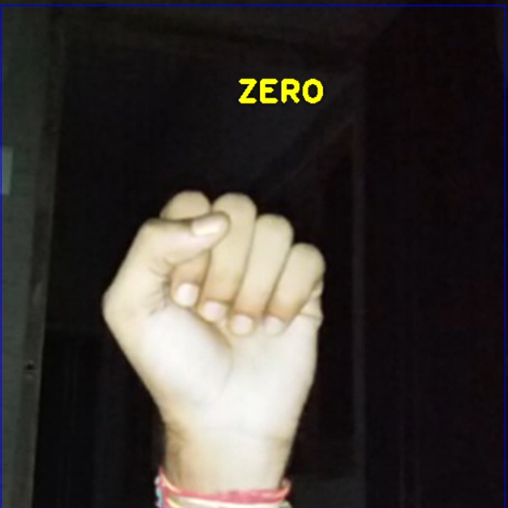
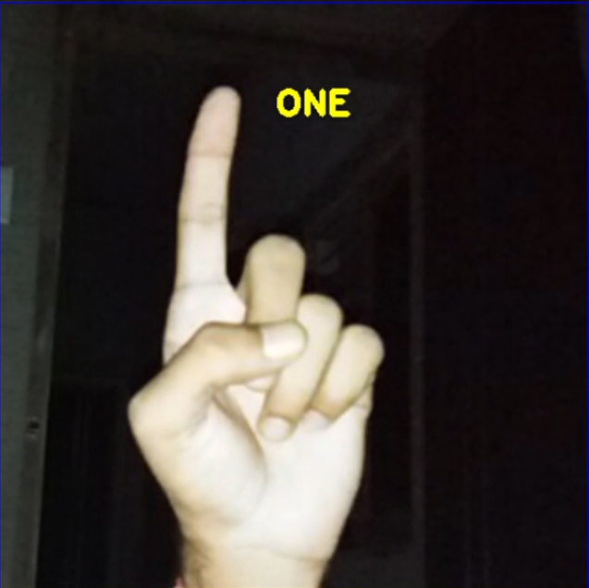
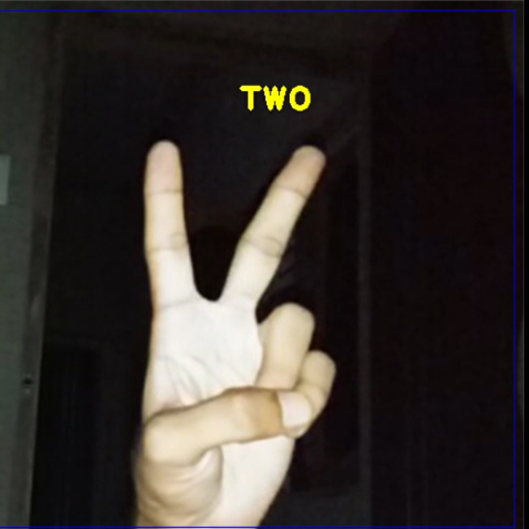
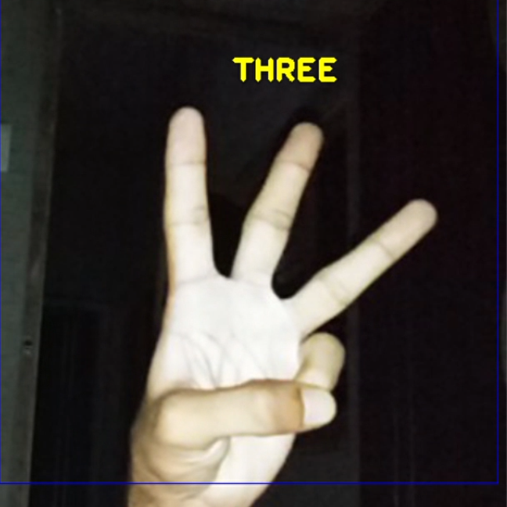
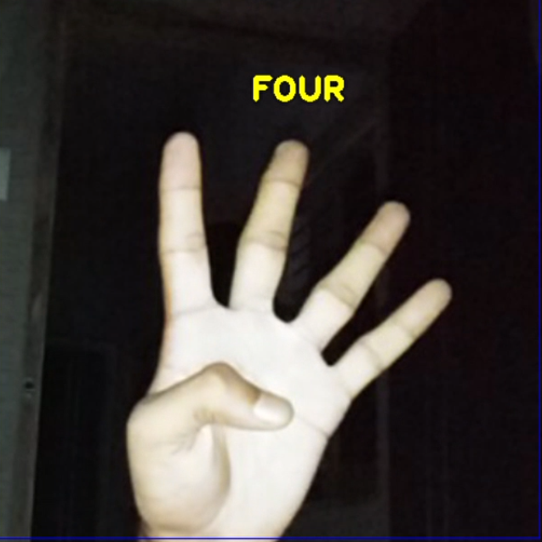
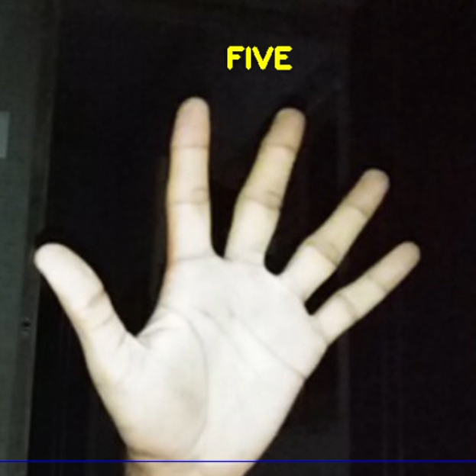
Gesture Recognition

Slide 24
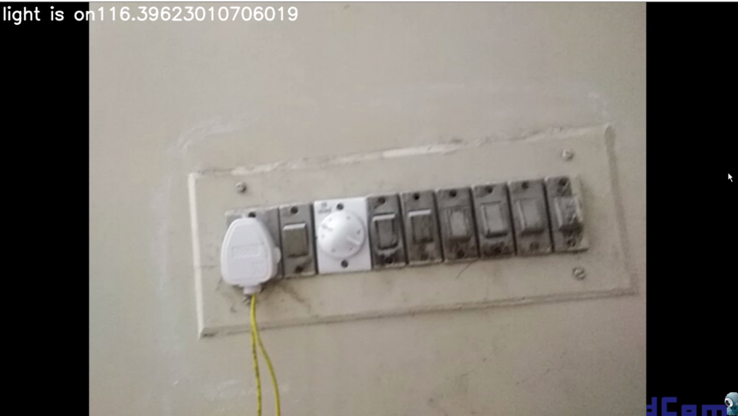
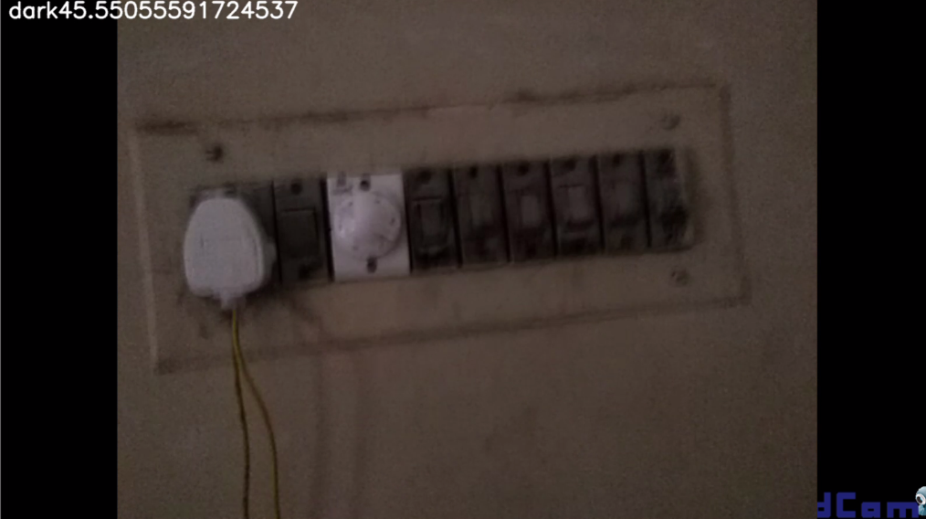
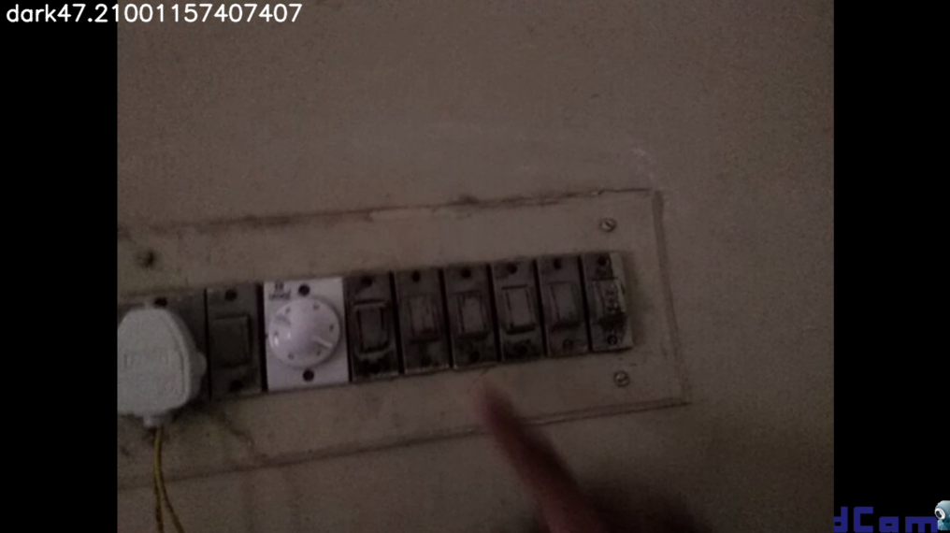
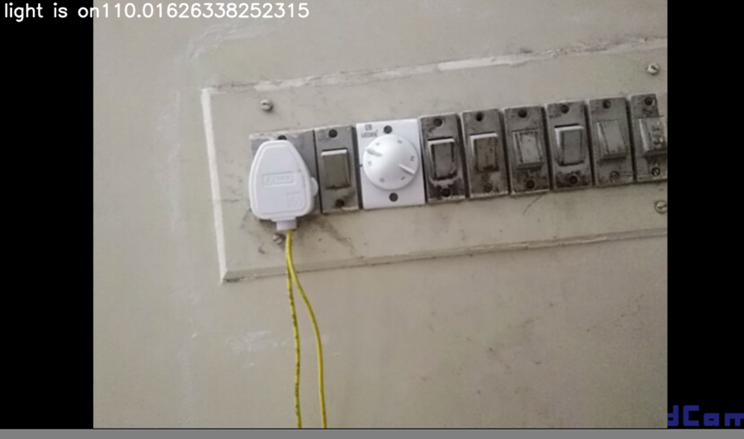
Light Detection

Slide 25
Thank You

